Slide 1
Branding and User Experience examples
French Laundry: http://www.frenchlaundry.com/
Atlanta Parish Foods and Goods: http://www.parishatl.com
Pizza Luche: http://pizzaluce.com/

Slide 2
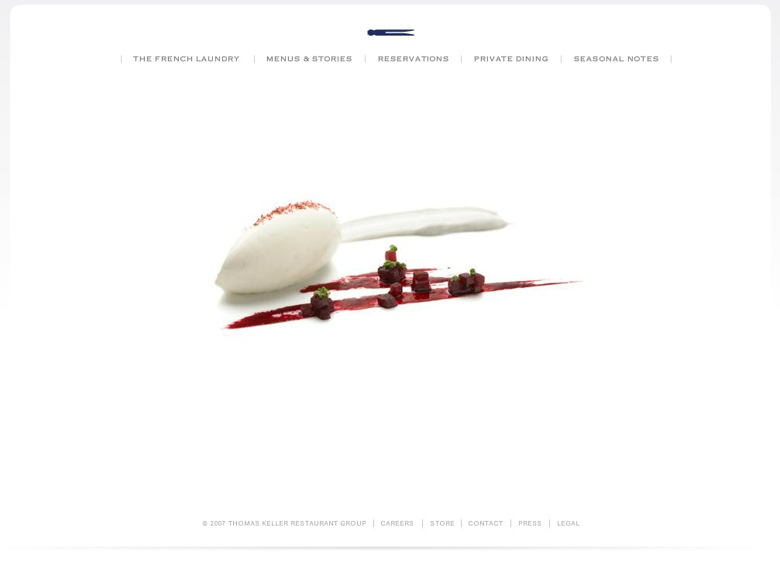
French Laundry: Clean, Simple, Refined

Slide 3
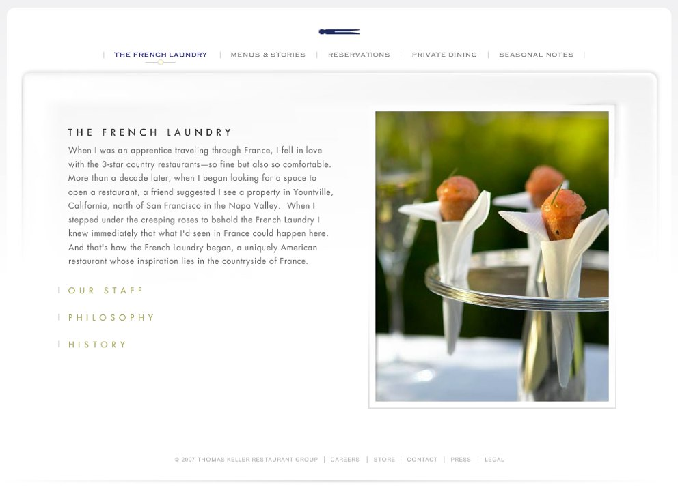
French Laundry: Clean, Simple, Refined

Slide 4
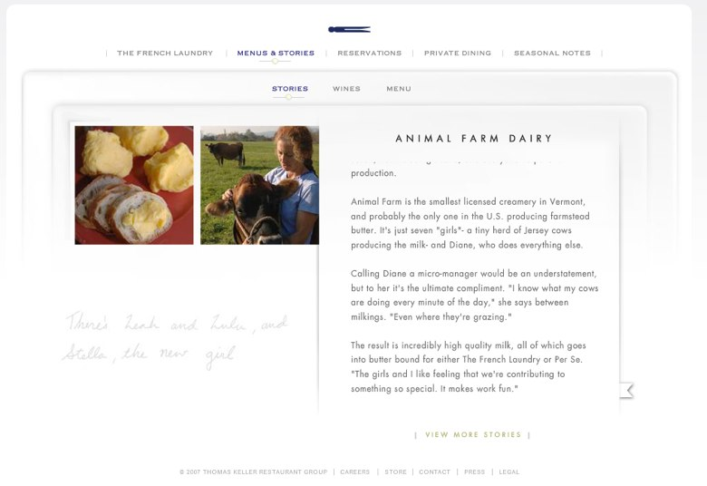
French Laundry: Clean, Simple, Refined

Slide 5
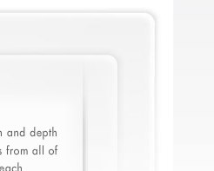
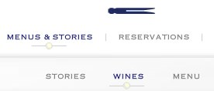

French Laundry: Clean, Simple, Refined
Main colors: Cool neutrals, grays, white
Accent colors: Blue, Yellow

